Slide 1
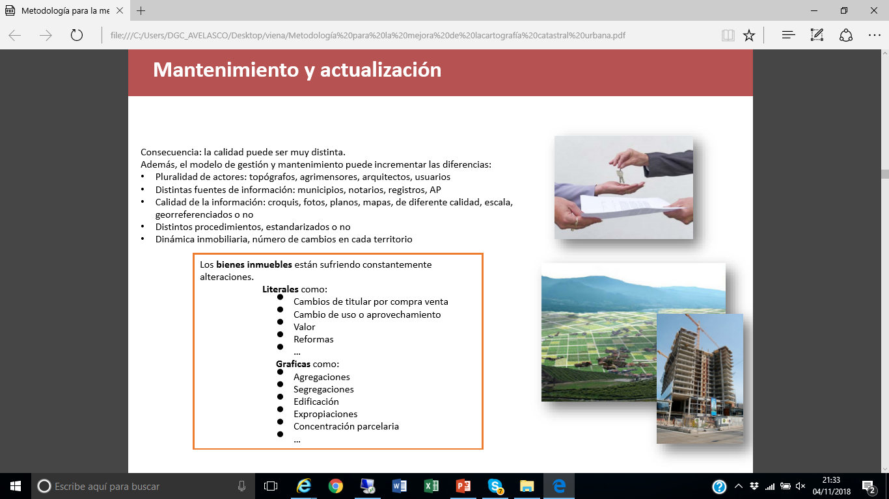
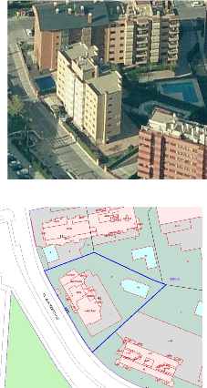

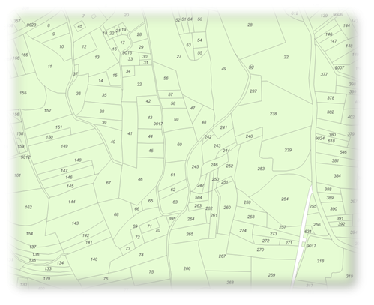

PCC 2018. Austria
Methodology to improve urban cadastral cartography in the Spanish Cadastre
Amalia Velasco
amalia.velasco@catastro.minhafp.es
Notes:
PCC 2018. Austria

Slide 2


Are the legal boundaries vey different to the fiscal ones?
…………….If you have a continuous map with legal and no legal parcels without gaps and overlaps…….. then they must be very similars.
…if the map that Finland cadastre shows to users is de cadastral index map……if you want to improve the quality …………………….. This meants improve the quality of the cadastral index map

Slide 3

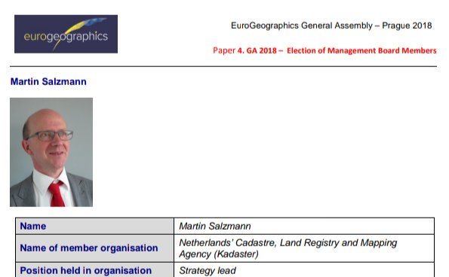
If there are the digital coordinates but they are different and less precise that the surveyor maps…………….why not try to improve the digital ones, …….is possible?
Why to keep 2 different ?
Digital It is continuous ……isn’t it more efective that one by one?
If the reliability is what users use
Is the reliability the legal boundary or the cadastral index map?

Slide 4
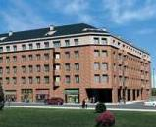
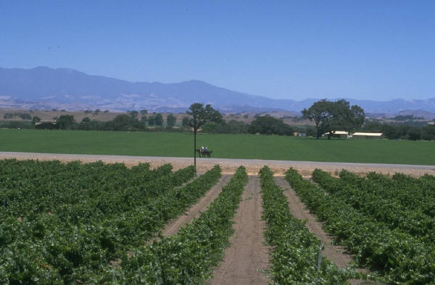

Administrative Register (Ministry of Finances)
  Available to public policies and citizens requiring information from the Territory (by Law)
The cadastral description of the real estate will include its physical, economic and legal characteristics as location, cadastral code or ID, surface, use, crops, cartographic representation, cadastral value, titleholder, etc.
URBAN
RURAL
SPECIAL

Slide 5
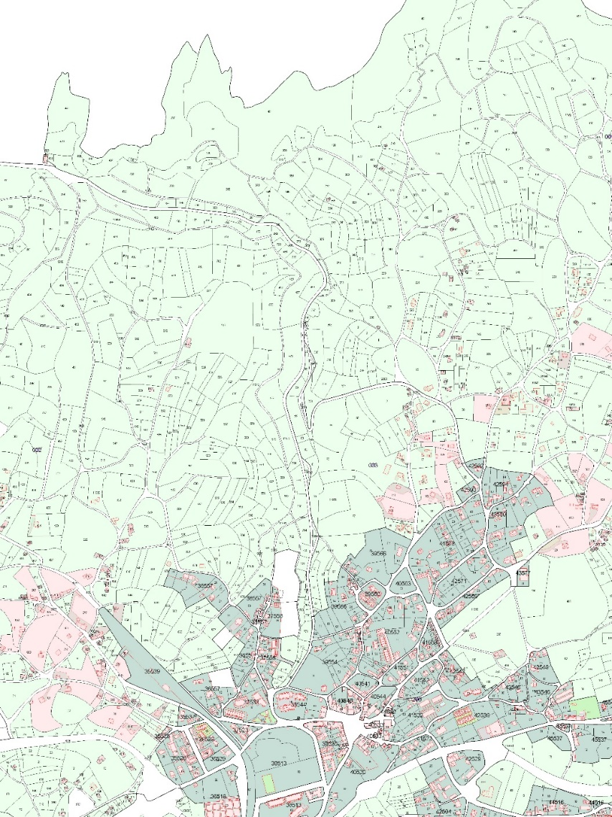
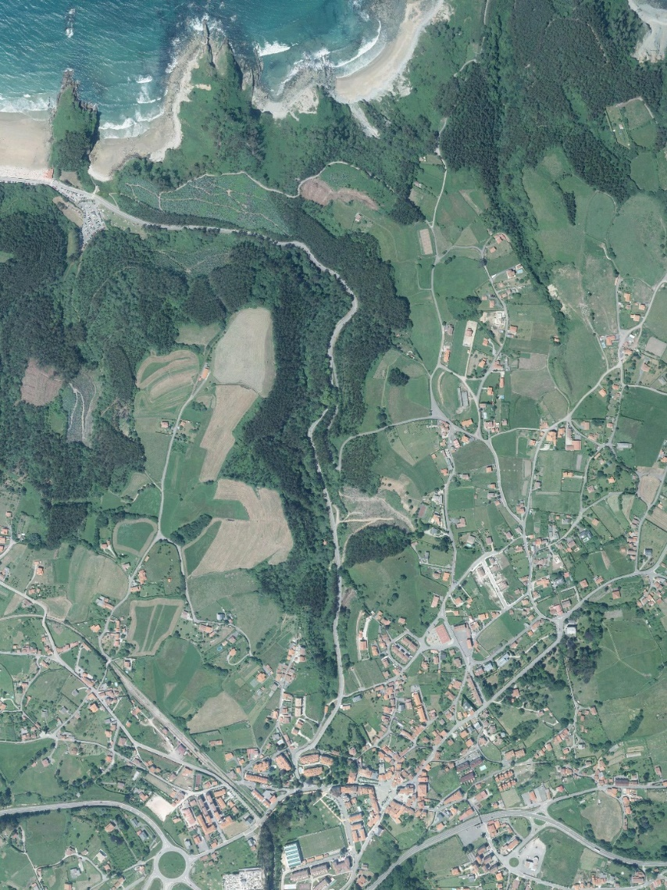
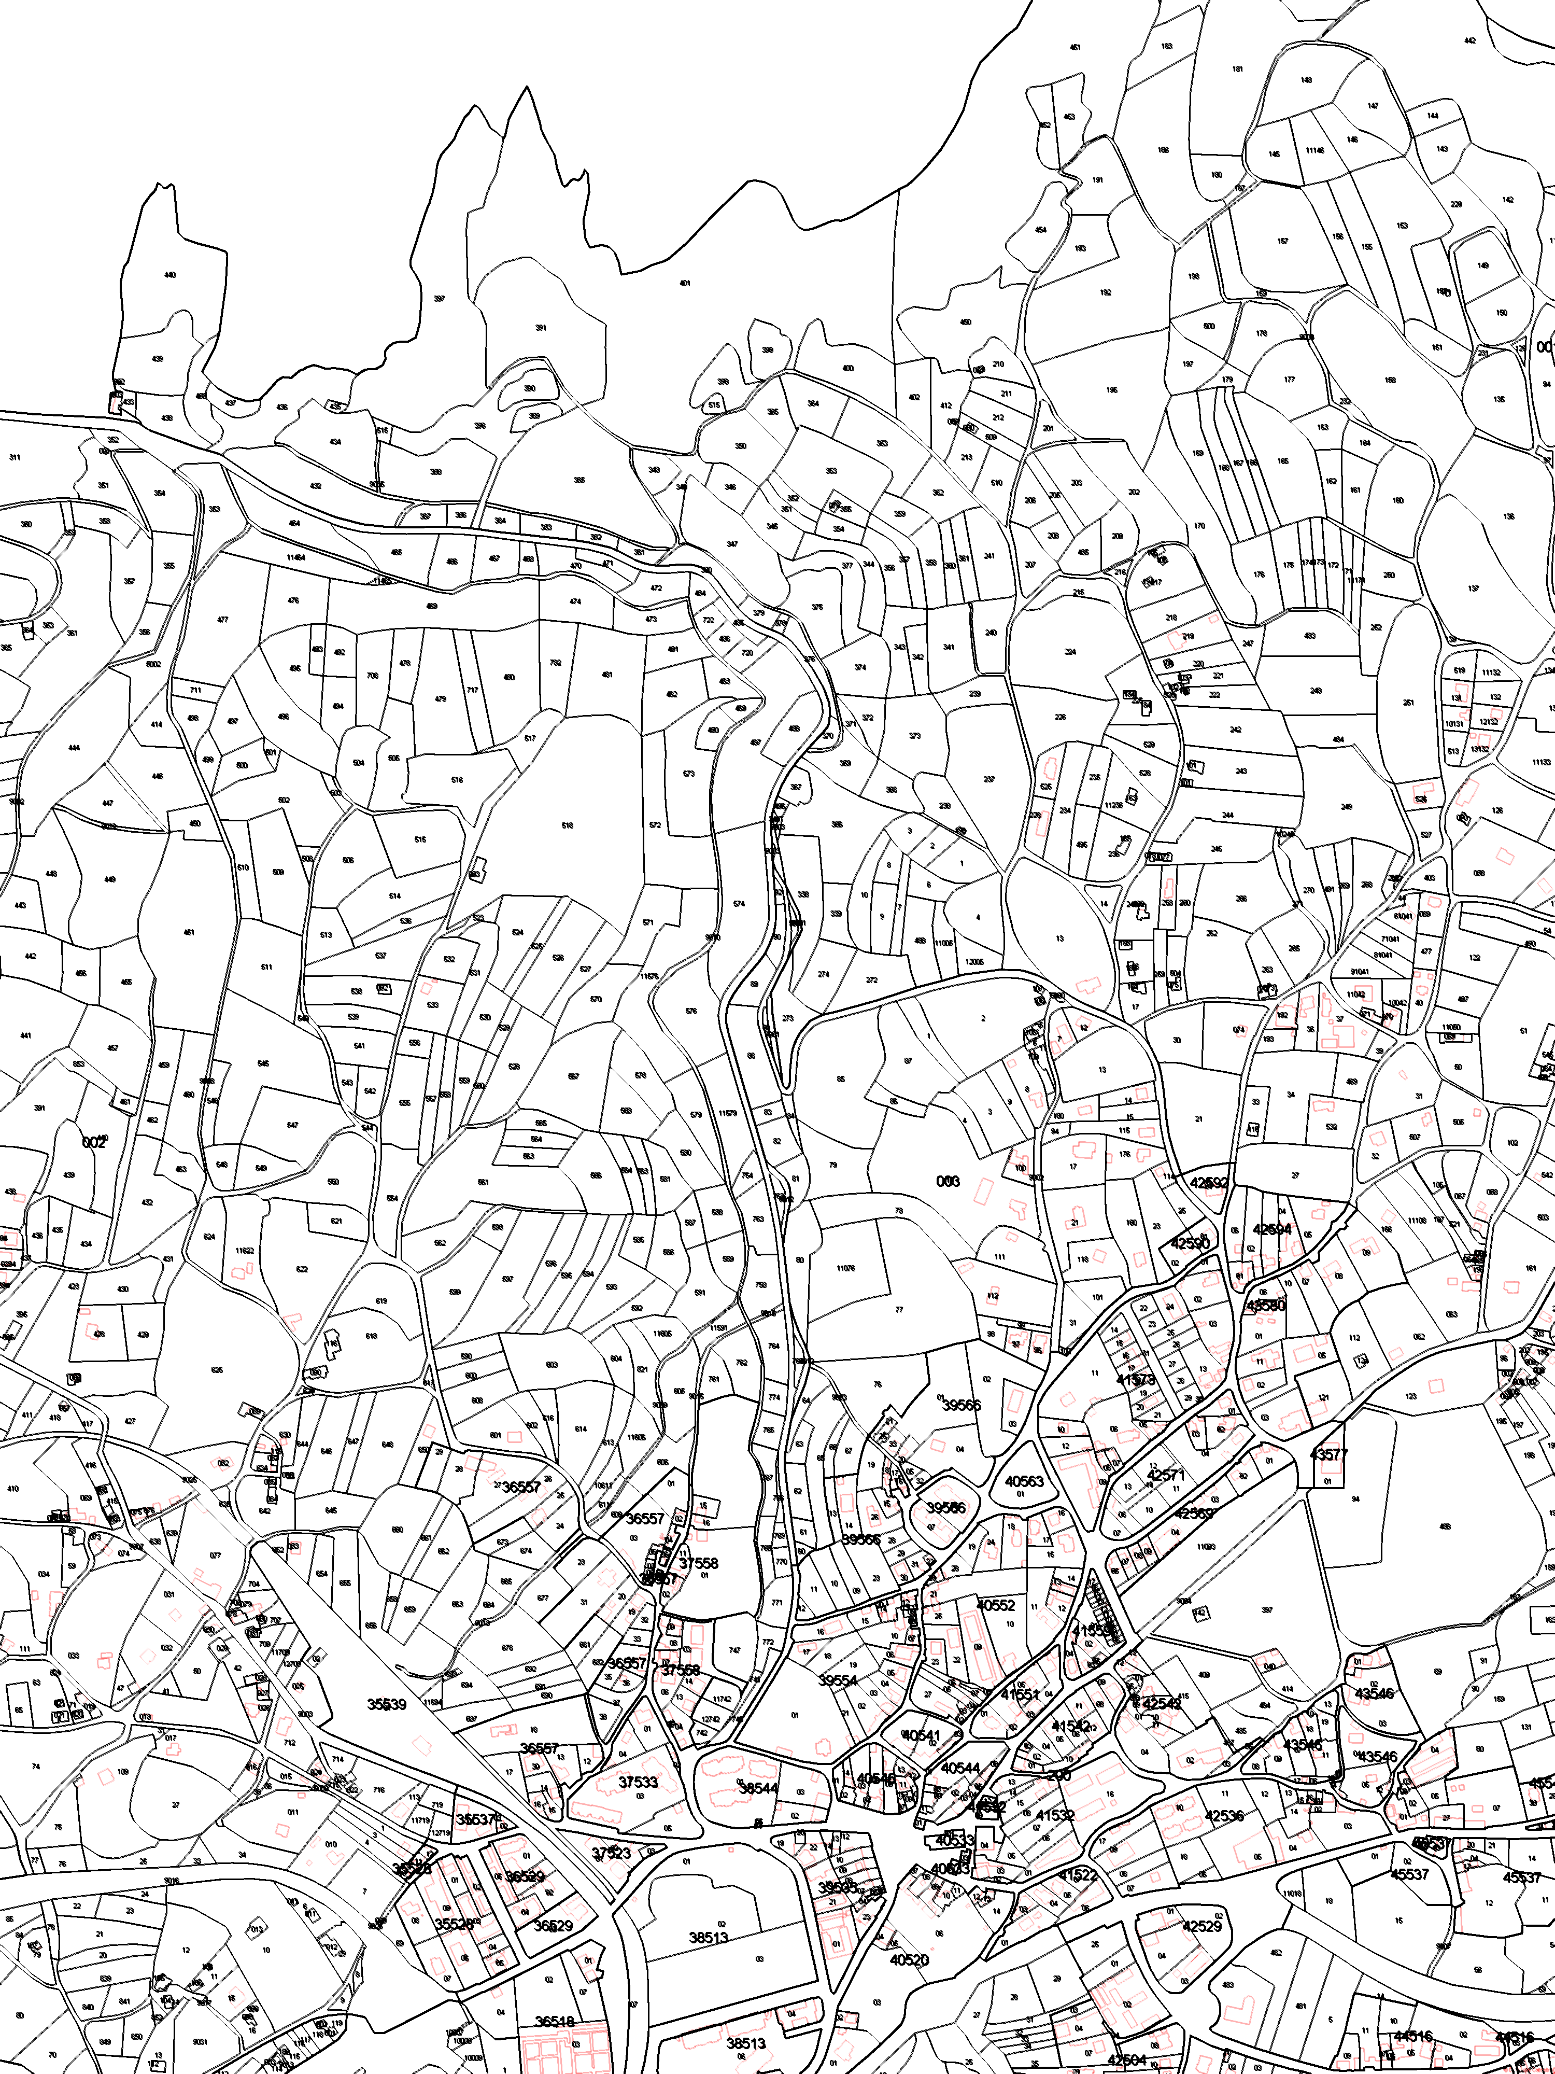
Main task for the Spanish cadastre: Valuation
Our values are the base for taxation
Main income for municipalities
The Cadastral GIS
The cadastre has information on all rural and urban parcels in a homogeneous way, as a territorial continuum,

Slide 6
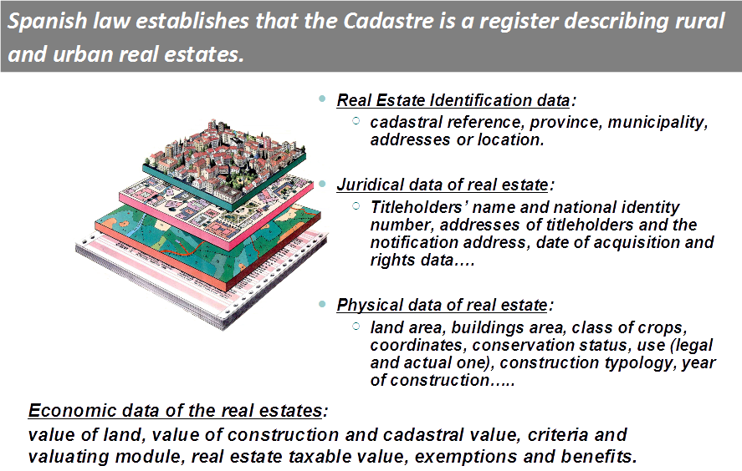

Slide 7
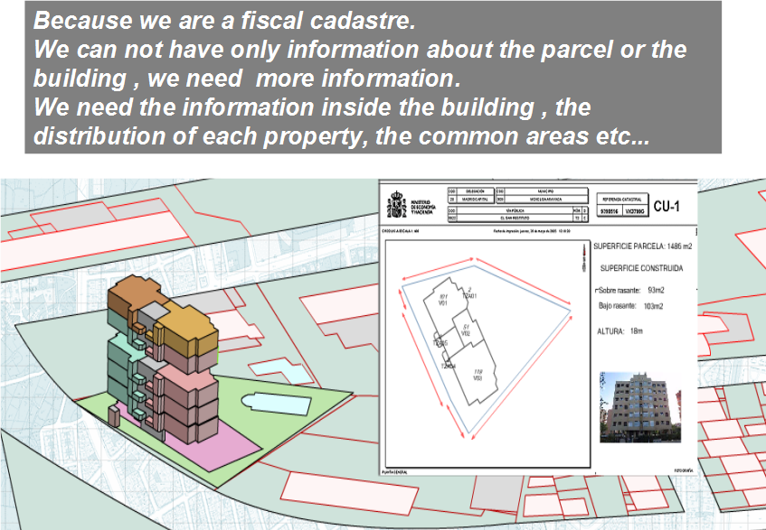

Slide 8
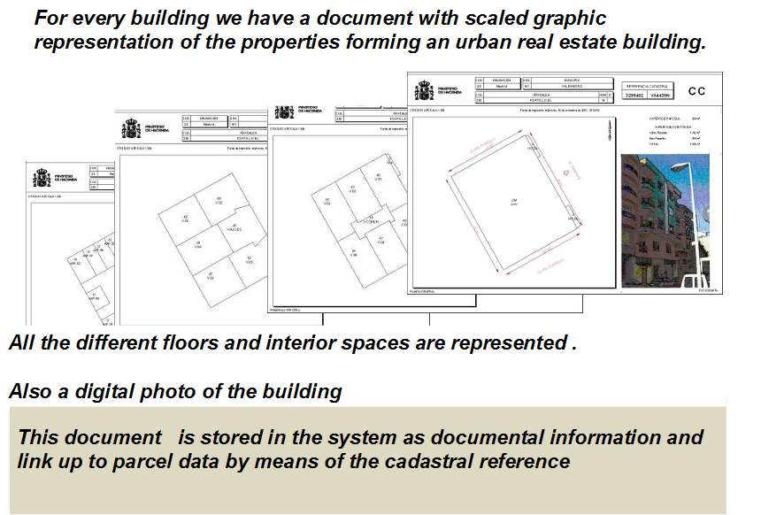

Slide 9
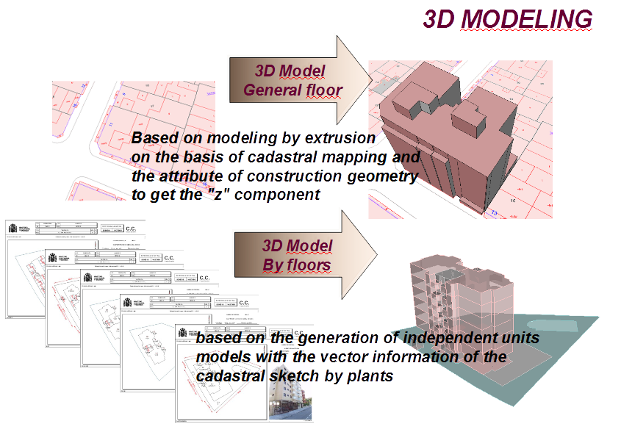

Slide 10
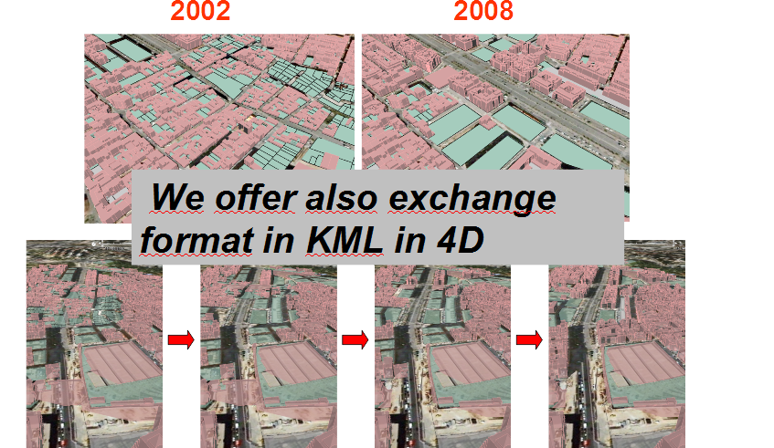
4D cadastre….3D + time
Notes:
4D cadastre….3D + time

Slide 11
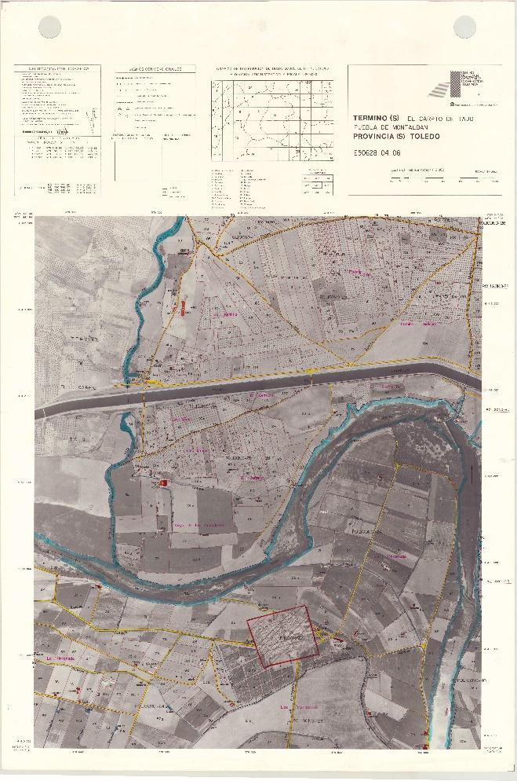
Cadastral Cartography
More than a century of cartographic works
Topographic survey
Photogrametry
In 70’S urban maps over topographics maps
In the 90’S to 2002
  Ortophotography and field Works to update rural maps
  Digital cartography
From them digital manteinance
In 2004: cartography in internet

Slide 12
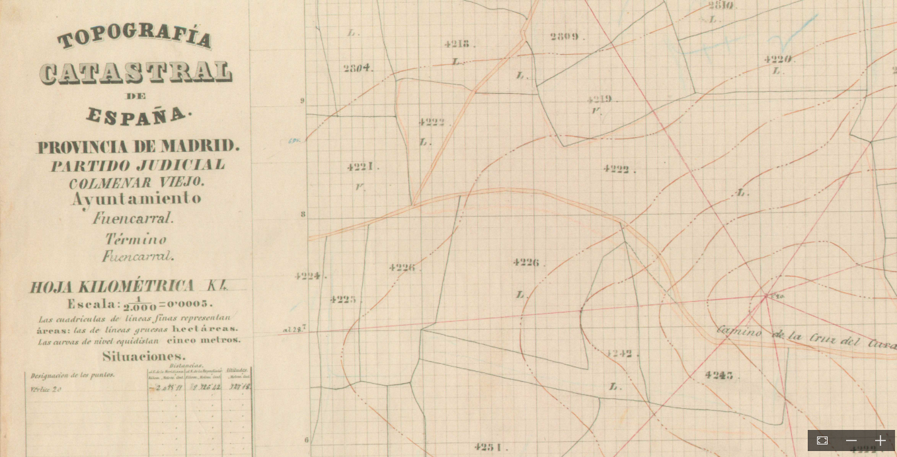

Slide 13
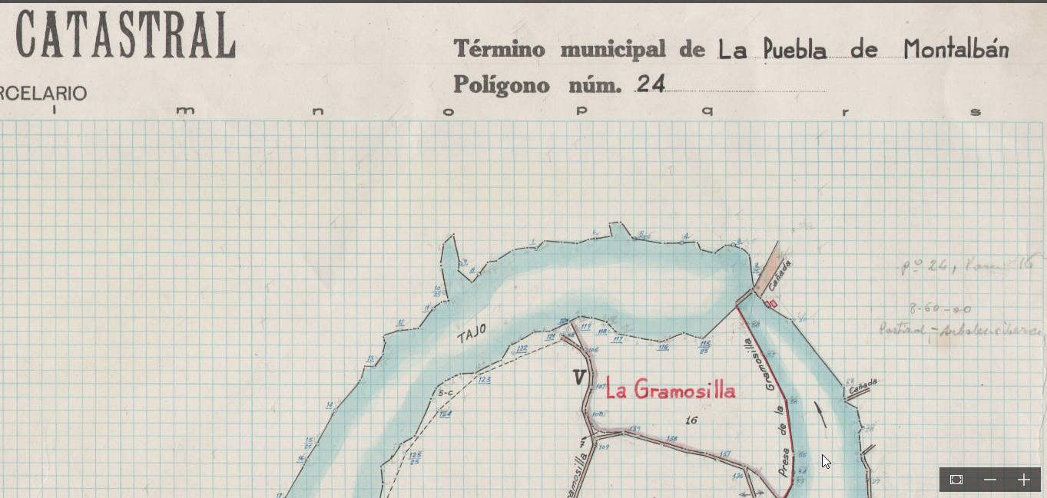

Slide 14
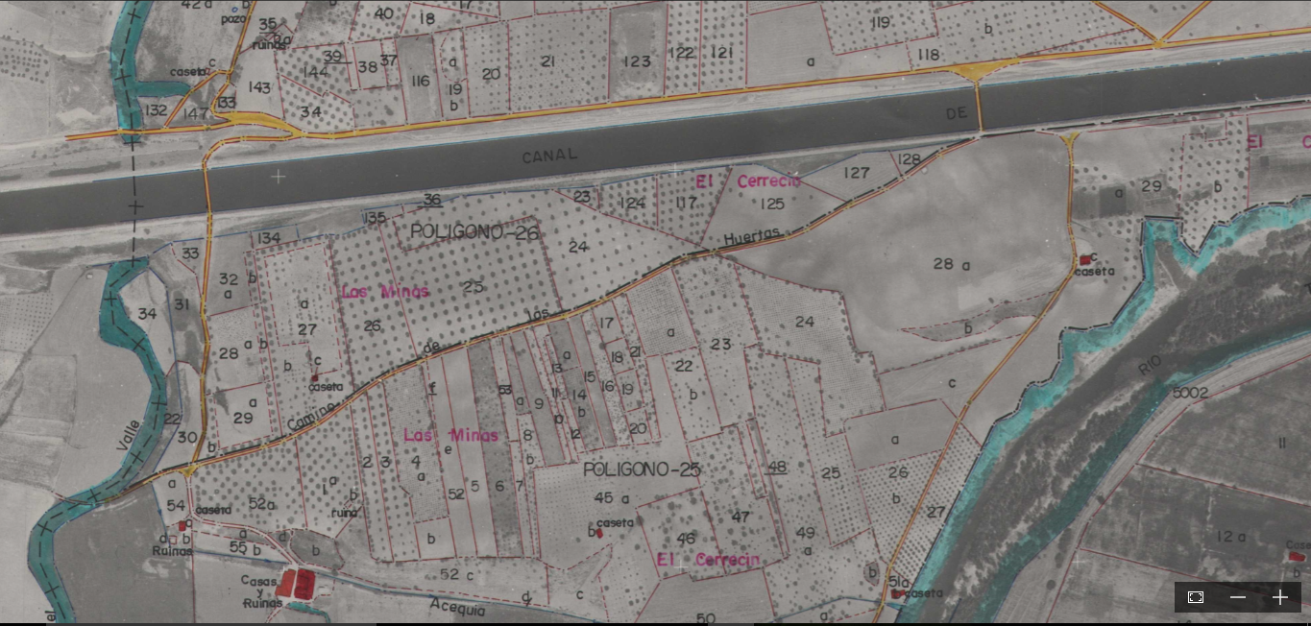

Slide 15
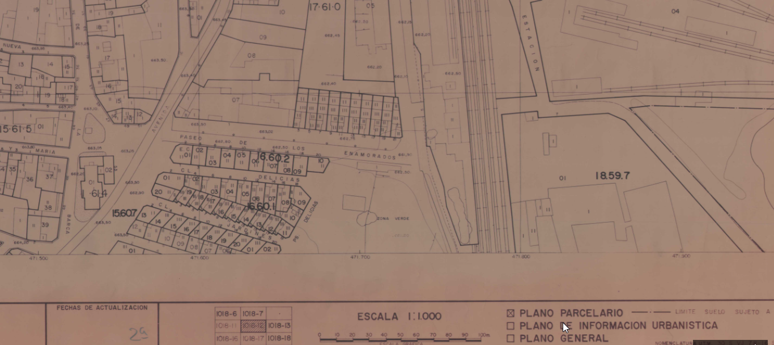

Slide 16

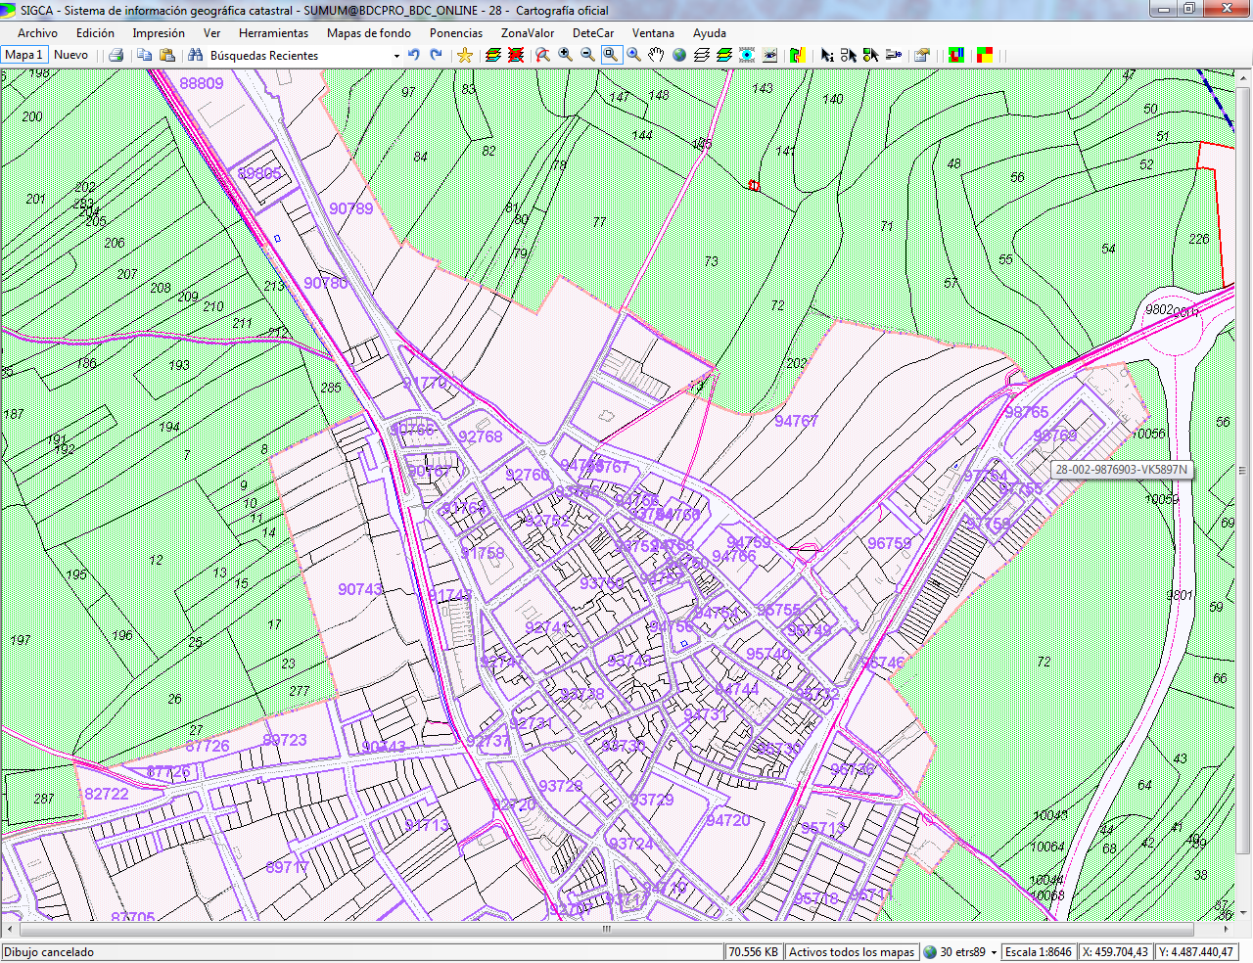

SIGCA (Cadastral GIS)

Slide 17
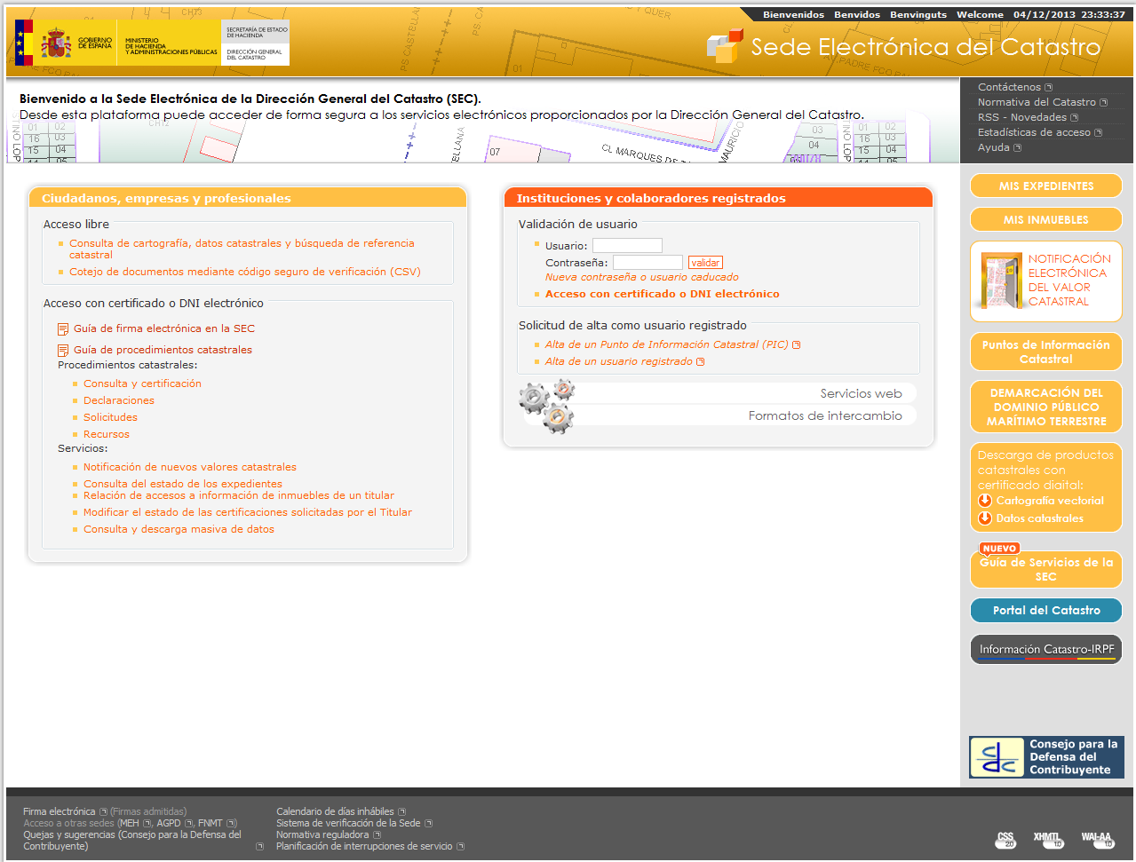
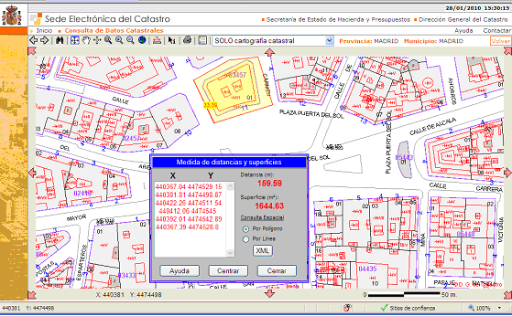
Cartography in electronic website
From 2004 The cadastral maps are free and open to everyone for viewing and download , 24x7
Annual maps download: over 180 M

Slide 18
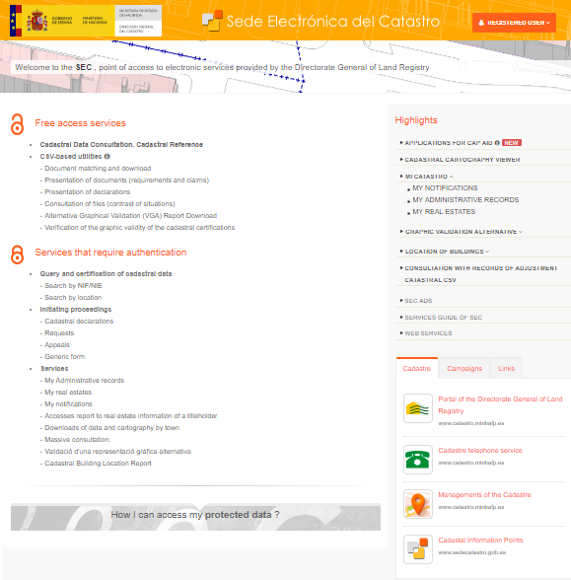
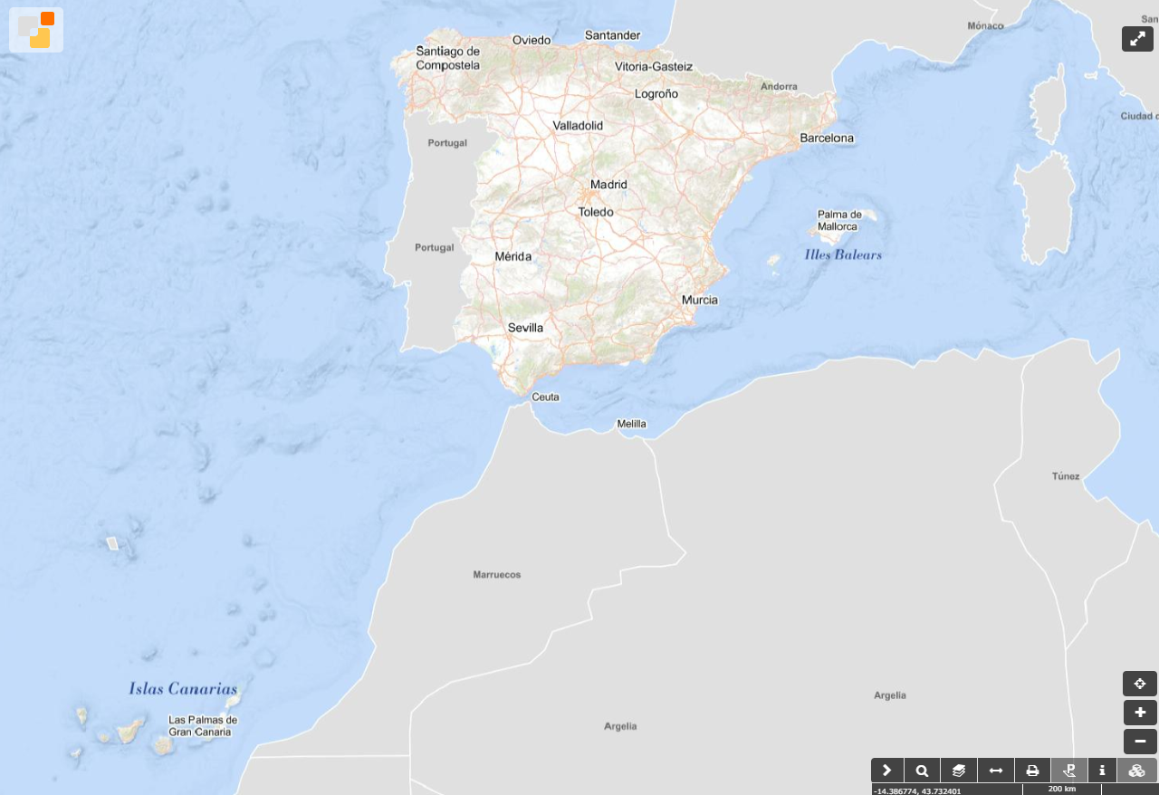

Cartography in electronic website
Viewer
We have continuous cartography of all our territory of management (almost 500,000 km2)
available through the electronic office,
viewer that allows users to navigate from an overview of the complete territory to approach each one of the parcels and units
and also through the map access to the most relevant alphanumeric characteristics of them.
https://www1.sedecatastro.gob.es/Cartografia/mapa.aspx

Slide 19
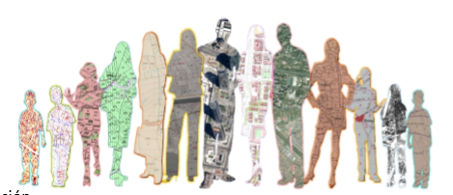

The fiscal Cadastre has become a Multifunctional Cadastre
Legal security and fraud control in real estate traffic:
Location and identification of the properties.
The cadastral reference as "Real estate identifier“ in
deeds- Rg. Property / Tax ation/ Contracts / Valuations
Social and aid policies
Energy reports
Policies, infraestructures, services
• Urban planning, land use
• Networks of services and supplies
• Agrarian, environmental, building features
• Other rights, limitations and restrictions
• Risk maps, civil protection, emergencies
• Linking or support of statistical data (geo-statistics)
Este uso múltiple del catastro introduce requerimientos: • Nuevos atributos o características • Vinculación de la unidad básica (finca, parcela, predio, bien inmueble) con diferentes características o atributos • De georreferenciación y localización de datos y bases de datos • De georreferenciación y localización de los hechos, actos, negocios y en general fenómenos que ocurren en el territorio • Todo ello incide básicamente en dos características: • La necesidad de una mayor homogeneidad de información • La necesidad de asegurar una calidad mínima del dato cartográfico, geométrico en todos sus aspectos

Slide 20
The fiscal Cadastre has become a Multifunctional Cadastre
This multiple use of the cadastre introduces requirements:
• New attributes and characteristics
• Link of the basic unit (cadastral parcel, building, real estate) with other object or attributes
• Necessity of geo-referencing and location of the events, acts, business and in general phenomena that occur in the territory
Need of a greater homogeneity of information (standardization and interoperability)
Need of access and exchange of cadastral information
Need to ensure a minimum quality of the cartographic data

Slide 21


Law 13/
Cadastre – Property Rights Registry Coordination
To give real estate traffic greater legal certainty by incorporating the georeferenced graphic information of the parcels in the Property Rights Registry,
- the cadastral map as the basis of its graphic representation,
-allowing simultaneously the updating and correction of the cadastral data.

Slide 22
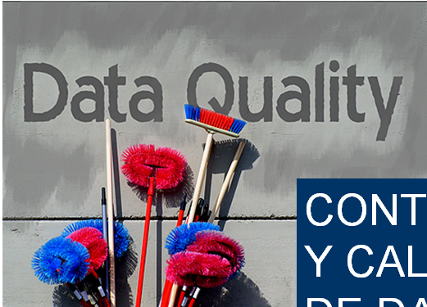
The cadastral cartography is the basis of the Property Rights Registry
Once the cadastral data is coordinated by the Property Rights Registry, the delimitation, location and area of cadastral data are considered to be true for all legal purposes.
It obligue us to improve our quality
Notes:
All this obligue us to improve our quality

Slide 23
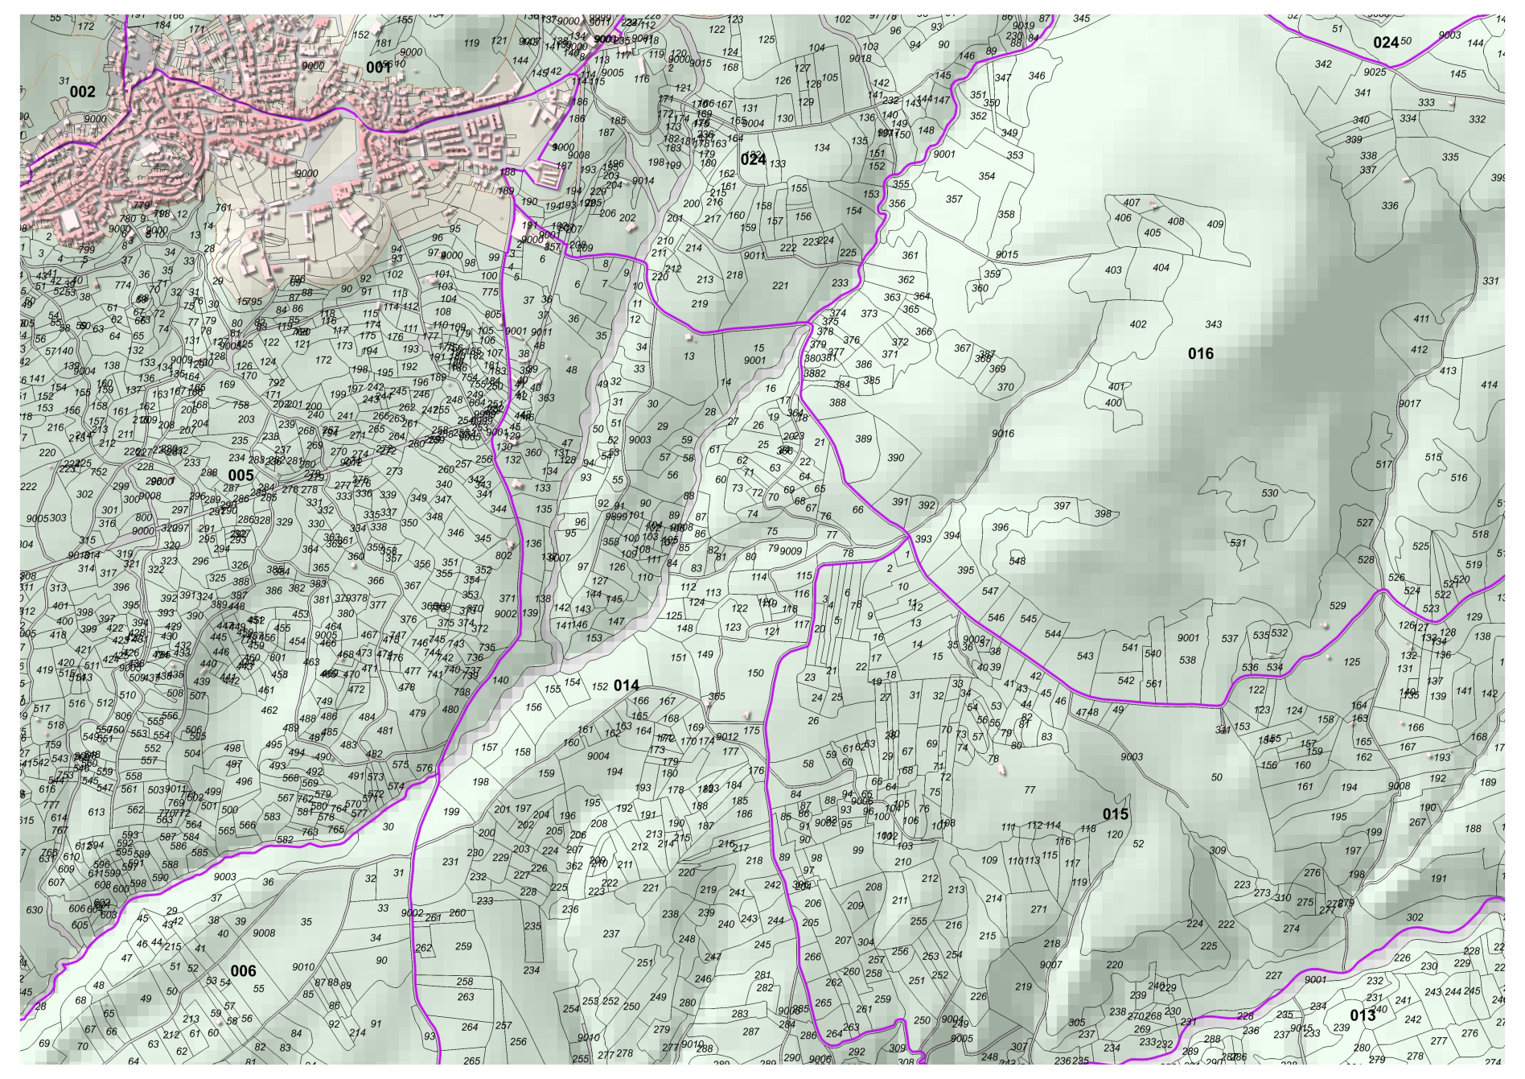
The cadastral cartography
COMPLETE and UPDATED
CONTINOUS
OFFICIAL, IT HAS PRESSUMTION of CERTAINTY
GIVES TRANSPARENCY AND SECURITY TO REAL ESTATE TRAFFIC
OBTAINED ACCORDING TO STANDARD IN COLLABORATION
WIDELY USED, PUBLIC, FREE, ACCESIBLE.
Atribute quality control
Graphical quality control
Topological quality control

Slide 24
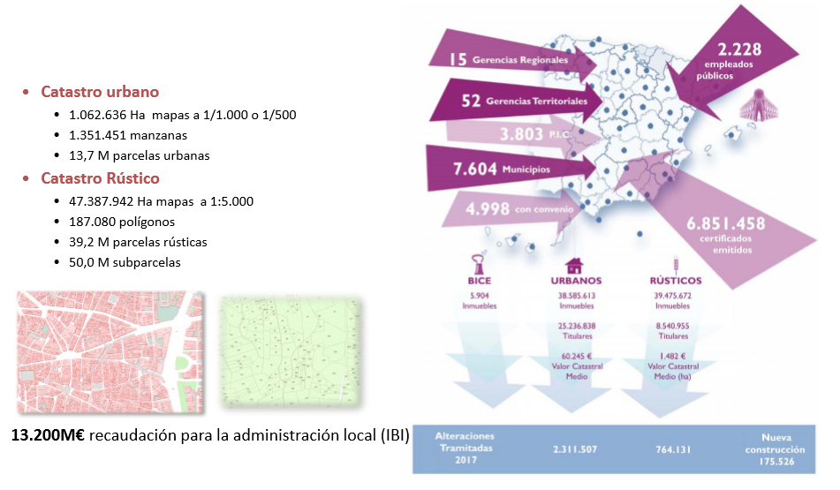
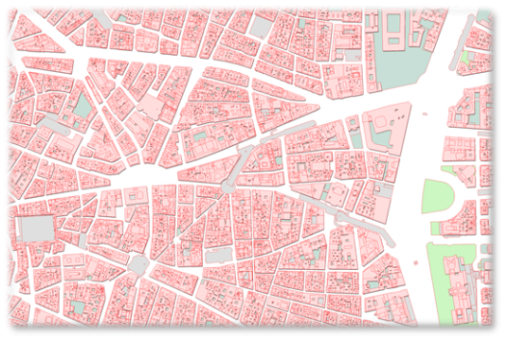
Cadastral basic data / Daily updating
Urban Cadastre
  1.062.636 ha maps 1/1.000 o 1/500
  12 M de buildings
  14 M cadastral parcels,
  39 M urban units
  6.500 real estate updated daily, 480 new constructions
Rural Cadastre:
  47.387.942 ha maps a 1:5.000
  39,2 M parcels
  2.500 real estate updated daily

Slide 25








creation, update and maintenance of the cadaster in collaboration:
  Compulsory Declarations of titleholders
  Institutional collaborators
    AGRICULTURAL MINISTRY
    NOTARIES
    PROPERTY RIGHTS REGISTRARS
    SPANISH TAX AGENCY
  Collaboration agreements with municipalities and local and regional authorities
  Communications and supply of information from public administrations and other organisations; Public Domain managers, expropiations, land consolidation, highways, railways, etc.

Slide 26

creation, update and maintenance of the cadaster in collaboration:
• Cadastral Survey
• On restituted topographic basis.
• On images basis(orthophotos, aerial photo)
• From documents (reparcelling, projects, etc.)
• other
Different origin
In addition, the management and maintenance model can increase the differences:
  • Plurality of actors: surveyors, architects, others
  • Different sources of information:
  • sketches, photos, plans, maps, of different quality, scale,
  • Different procedures.
Consequence:
the quality of the data can be very different.

Slide 27
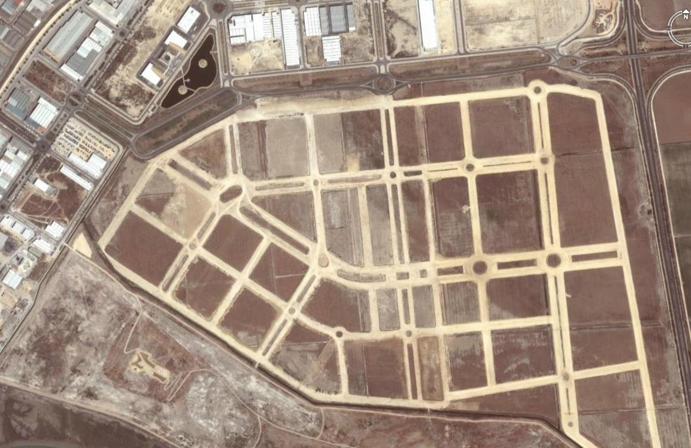
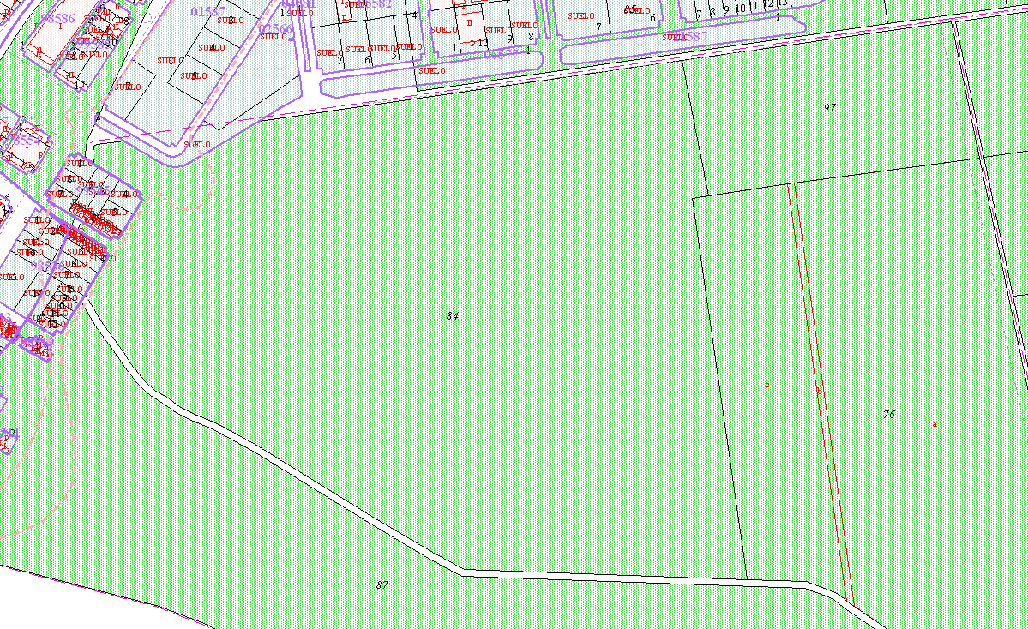
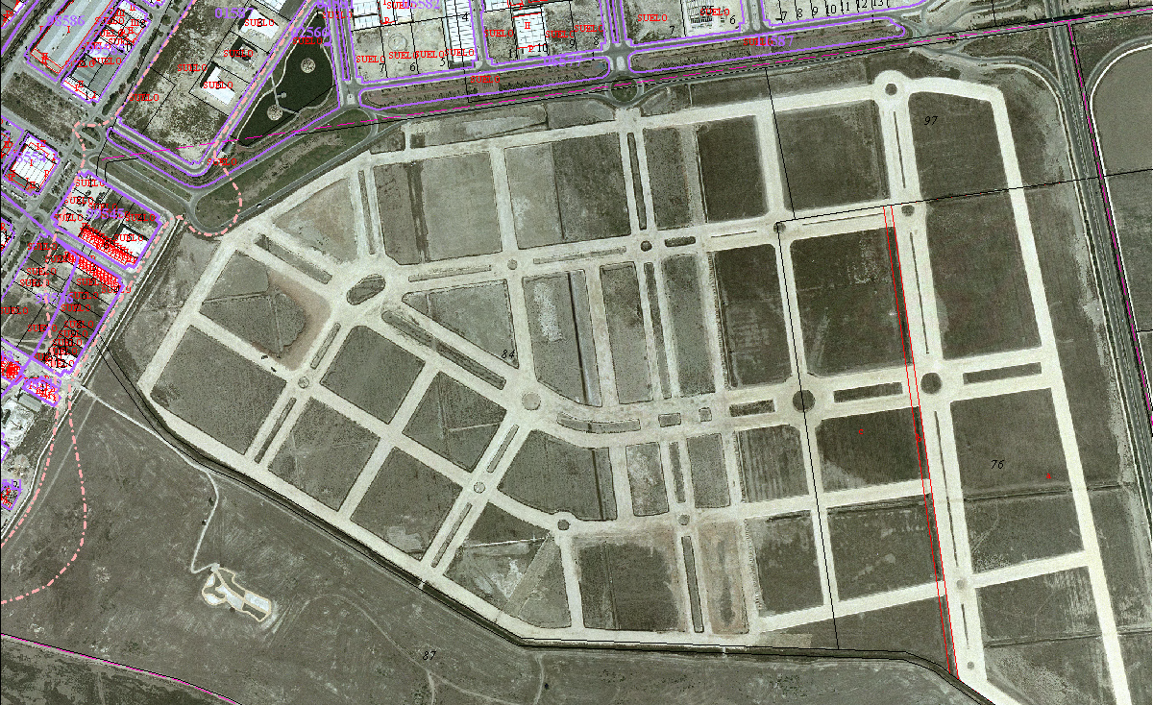
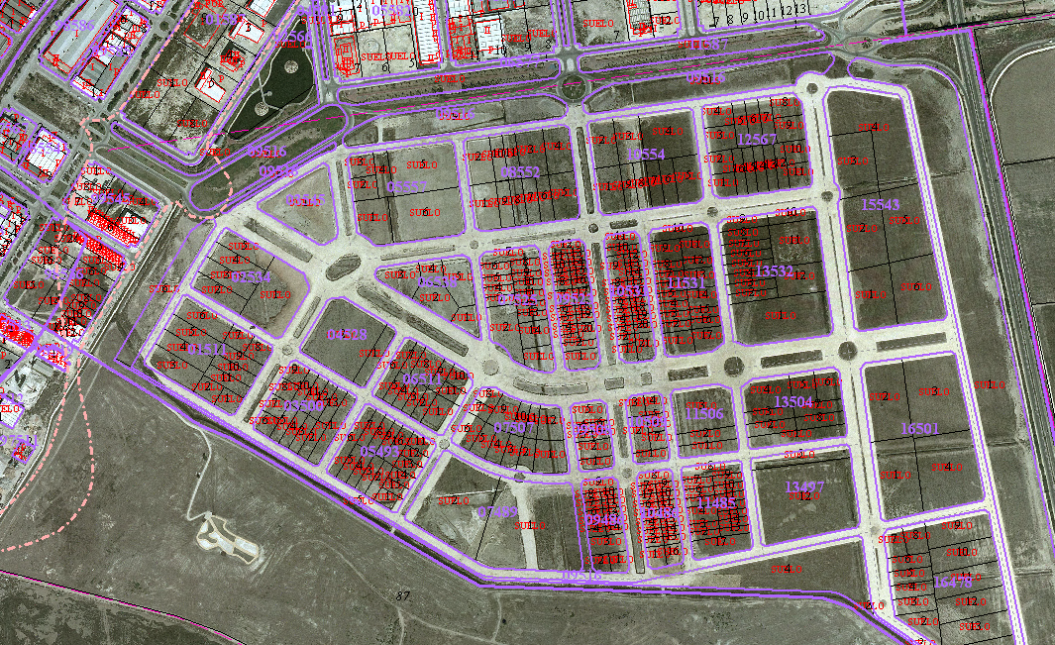
In Spain there are not licensed surveyors and it is not obligatory to mark boundaries in the ground.
But any alteration of the real estate must be declared to the cadastre
Mostly, when the parcels have physical changes, it is a surveyor who include the new coordinates in the cadastre contracted
sometimes by citizen
but mostly by other public administration

Slide 28
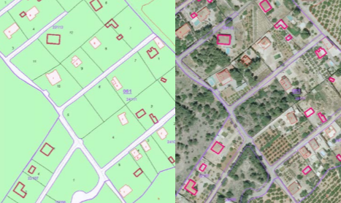
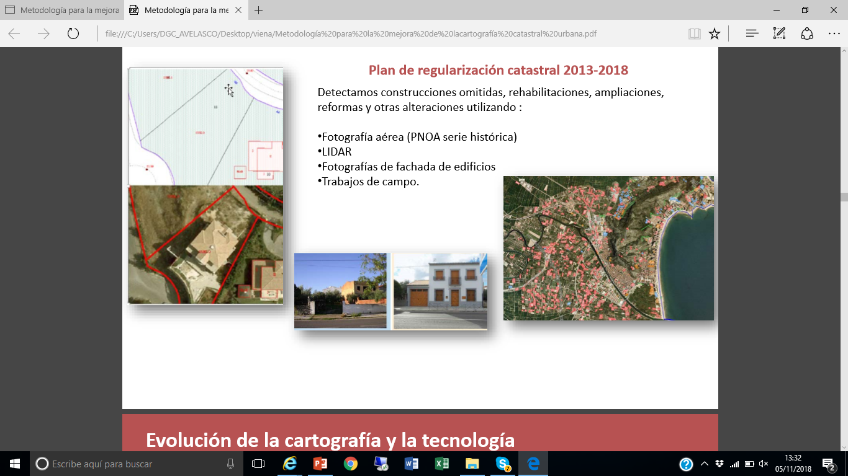
• Change in cartographic technology: GIS, WEB services.
• Evolution of measuring devices: Decrease in size, costs, times, increase precision.
• Photogrammetry: multispectral sensors, cameras and digital images, automated processing, automatic correlation.
• Orthophotos, true ortho, LIDAR, mobilemapping
• Satellite images: Quality, frequency, resolution
• Change detection tools,
New cartographic tools
All this technology has improved the processes of data collection and also our ability to inspect changes or detect errors

Slide 29

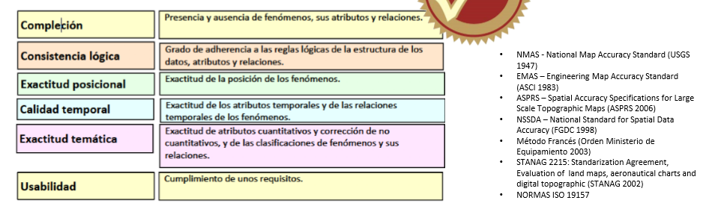
Normas y estándares de calidad: exactitud posicional
• Cadastral Survey
• On restituted topographic basis.
• On images basis(orthophotos, aerial photo)
• From documents (reparcelling, projects, etc.)
• other

Slide 30
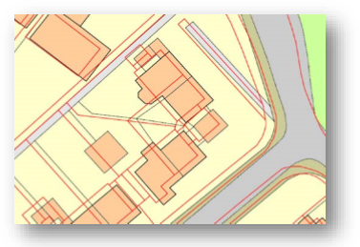
Improvement of positional accuracy
Some considerations:
• Making new more accurate cartography is very very expensive….impossible
• Improve the accuracy and precision of a map, it is also expensive
• The precisions and scales of the cadastral cartographies must be reasonable and proportional (urban, rural).
• A plan of a parcel, a specific demarcation of a piece of land , ………………………………………………..is not the same as doing all the cartography of the country.
• There are already proven programs to improve the positional component (PAI)
Notes:
Calibrate…Arturo
Homogeneity Maja

Slide 31

One of the current strategic objectives of the D.G. of the Cadastre
Purpose:
Provide the cadastral cartography of all the characteristics that allow compliance with the provisions of Law 13/2015
Improvement objectives:
• Correction of the cartography in its component of positional accuracy.
• Adjustments necessary to improve the agreement between the cadastral parcel and the reality.
First urban cartography

Slide 32
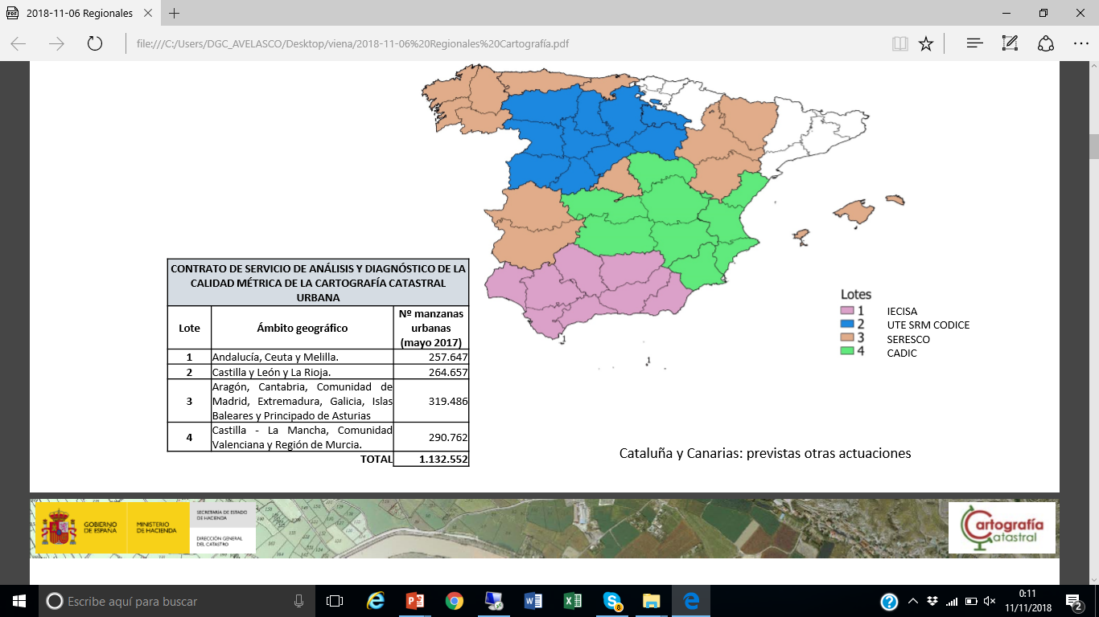
Work plan:
First step
Study of positional accuracy of urban blocks .
Contract private surveyor companies.
Big investment. All territory
1
study of errors
2018-2020
2
Decisions for correction
Wich zones automaticaly, wich with deeper study and fields work
3
Corrections
Legal and practical procedures-
Which metodology for corrections

Slide 33

Previous conceptual analysis: PRECISION, TOLERANCE, ERRORS
• PRECISION: The accuracy of CATASTRAL CARTOGRAPHY responds to the scale and technique used in its survey and to the techniques of subsequent maintenance:
• TECHNICAL TOLERANCE MARGIN: Accuracy of the graphic measurement according to the scale of representation. Defined in catastral regulation
• ERRORS OF GYRATION AND DISPLACEMENT: Between the plot and the cartographic support base used.
• POSITIONING ERRORS: Between the coordinate of the plot and the measurement on the ground
• Cadastral Survey
• On restituted topographic basis.
• On images basis(orthophotos, aerial photo)
• From documents (reparcelling, projects, etc.)
• other
Now
Better basic information

Slide 34
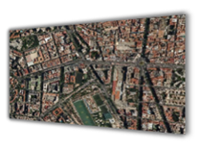

The national Plan of Aerial orthophotography (PNOA)
It is a decentralized and cooperative production between the different administrations
Aims to obtain digital aerial orthophotographic images with resolution 10, 25 or 50 cm
With an update period of 2 or 3 years, depending on the zones.
7,6 M euros
each 3 years
Aerial photography is the obligatory basis for the realization of cartography and geographic information: land occupation, urban planning and territorial planning, cadastre, forest management, hydrography, etc.
Using the same Photogrammetric data, we also achieve a perfect geometric and temporal coherence of the cartographic and geographic databases existing in all the administrations.
Notes:
7,6 euros
every 3 years

Slide 35
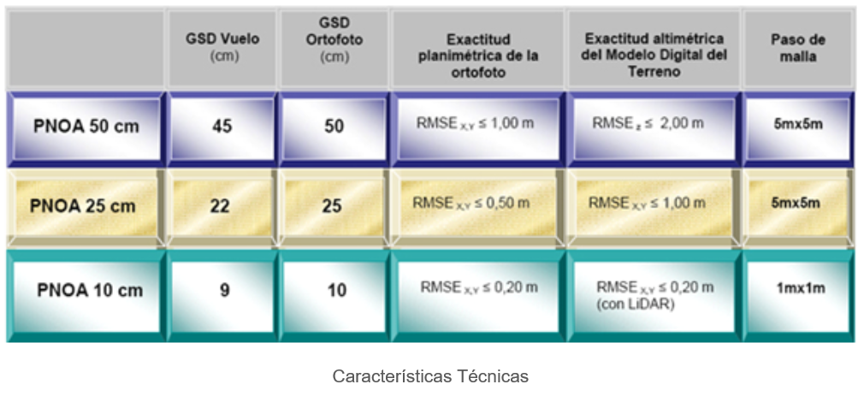
A single photogrammetric flight and rigorous data processing are carried out in compliance with the technical specifications agreed upon by all the participating public administrations that co-financing the production.

Slide 36
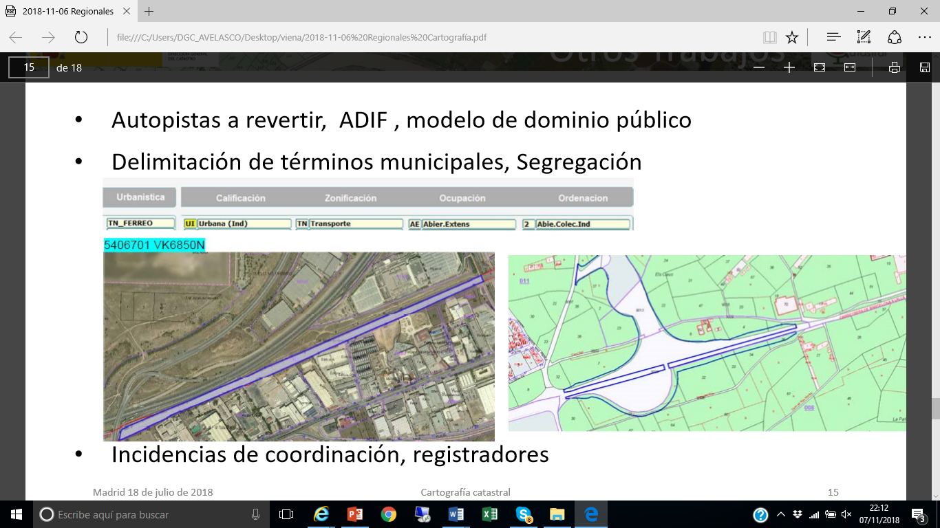
Study of errores
The positional accuracy of cadastral cartography shall be calculated by reference to the orthos of the Plan Nacional de Ortofotografía Aérea (PNOA)
•It's official and ensures compliance of the quality controls
•It covers the entire territory
• accuracy: is considered the minimum standard for cadastral purposes.
Other cartographic products of best quality metric may be used. Prior authorisation by the cadastre.
Notes:
Study of the errors

Slide 37
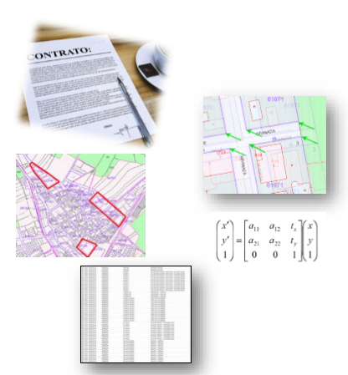
Study of positional accuracy of urban blocks
The surveyor company must provide:
• Vectors of transformation: identification of homologous points between the cadastral maps and reference cartography or orthophoto reference. Block by block.
• Zones: homogeneous zones of set of blocks with its parameters of transformation for its rectification.
• The level of correspondence of the cadastre with the physical reality
For this, the discrepancies found will be classified according to their typology. Catalog of incidents
• Quality by municipality : prioritization of action.
SHP file, with the homologous points captured in the cadastral cartography and in the reference data source.

Slide 38
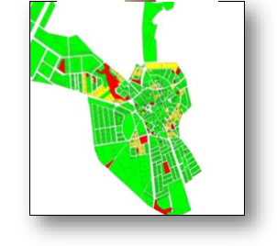
After the Study
• We will know the quality of metric positioning of each block of each municipality in the urban cadastral cartography.
• We can evaluate which actions or new cartography must be done
• Before carrying out correcting works, we can notify N+R of the mismatch in each area so that they can take it into account.
• In the zones that are susceptible to transformation we will know what parameters can be applied to make an automatic transformation in all layers of cartography

Slide 39
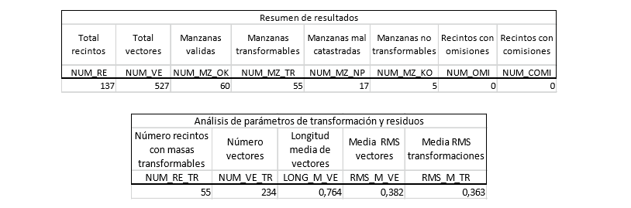
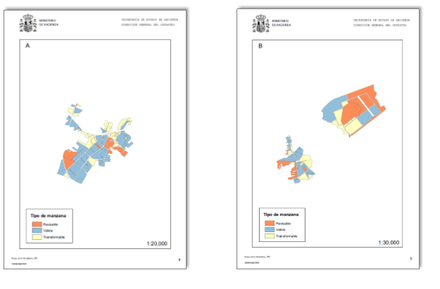

Slide 40
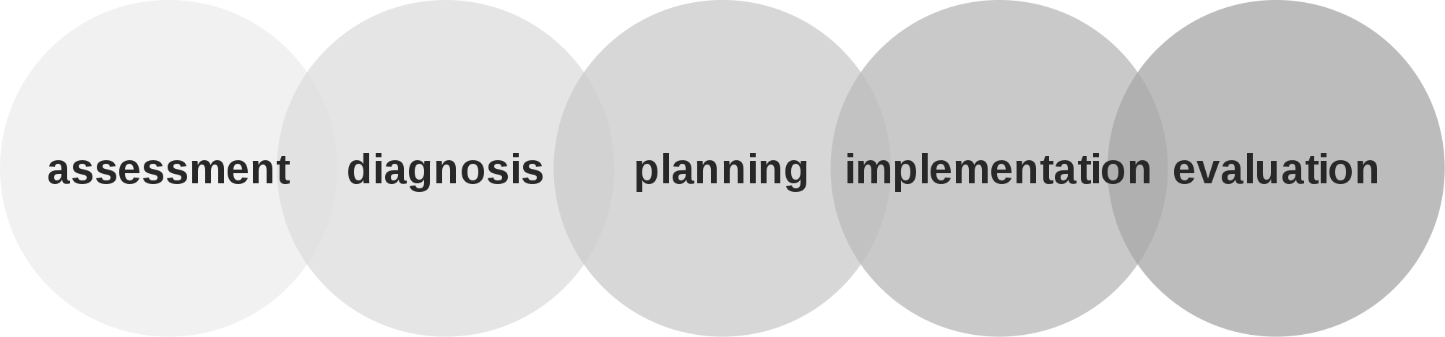
This is only the first step, the diagnosis.
Then we should decide which blocks are transformed automatically.
Notification to the owners and attention to the allegations ... new surfaces, new values.
Blocks not transformable, individual analysis and field work
And the extend the study to rural áreas, more dificult.

Slide 41
PCC 2018. Austria
Thanks for your atention!!!
Methodology to improve urban cadastral cartography in the Spanish Cadastre
Amalia Velasco
amalia.velasco@catastro.minhafp.es
Notes:
Thanks!!!

